Slide 1

SURE TRUST
MAJOR PROJECT (SQL & POWER BI)
ServiceNow Performance Analysis
Debasish Sahu - PGDM 2nd year (Business Analytics) - Team Coordinator
2. Sai Akash Lakkakula - B.Tech 4th year (AI & ML) - Team Member
3. Neeti Pandey - B.Tech 4th year (AI & ML) - Team Member
Mentor - Mr P Ravi Shankar – Tata ProEngage volunteer from (TCS)

Slide 2
Summary of ServiceNow Performance Analysis
Objective:
The project aimed to analyze ServiceNow performance by evaluating key metrics related to ticket resolution efficiency, trend patterns, and product line performance.
The focus was to assess how effectively the ServiceNow team managed ticket resolution and to identify areas for improvement.
Scope:
The analysis covered:
Resolution time: Measuring how quickly tickets were resolved.
Trend analysis: Understanding peak ticket inflow and resolution trends.
Product line-wise insights: Identifying which product lines had the highest ticket volumes and how efficiently they were handled.
Tools & Technologies Used:
Excel: For data cleaning and preprocessing.
Power BI: For creating dashboards and visualizing trends.
ServiceNow Reports: The primary data source for ticket-related information.
Outcome:
The project provided data-driven recommendations that could enhance service efficiency by identifying optimization opportunities and improving resolution strategies.

Slide 3






Data Flow Diagram
Data Extraction
Data
Preprocessing
Data
Analysis
Data
Visualization
Reporting
Removed Closed Incident States,
excluded Irrelevant Columns
Identified Trends, SLA Breaches, Priority-based Resolution Patterns
Power BI Dashboards (Trends, Priority Analysis, Resolution Times)
Presented Findings to Trainer
Retrieved Ticket Logs
ServiceNow Data
Extraction
Processing
Analysis
Visualization
Reporting

Slide 4
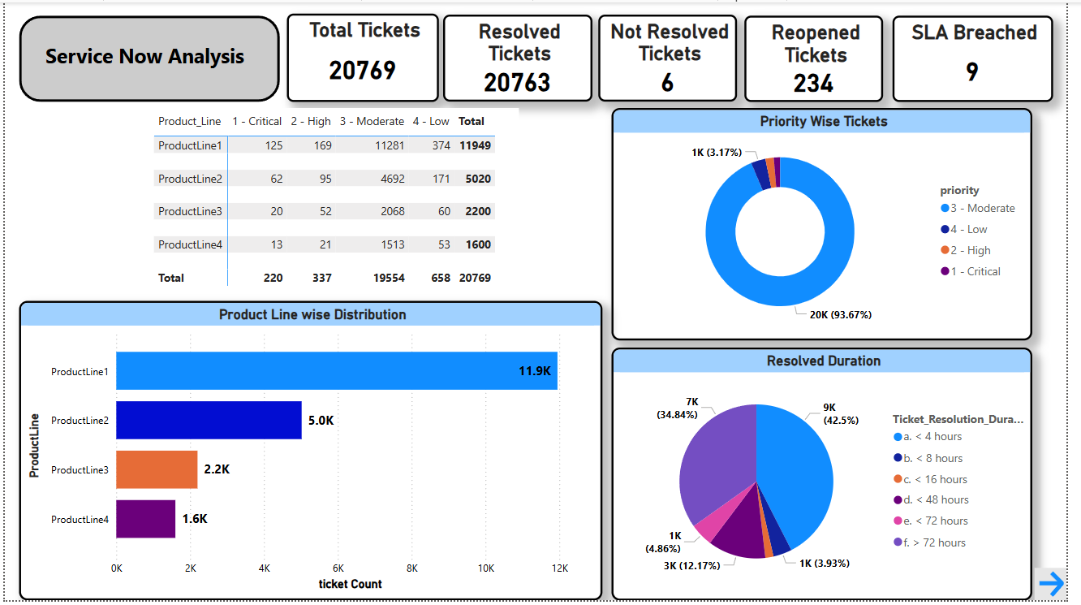
Final Project Outcome 1

Slide 5
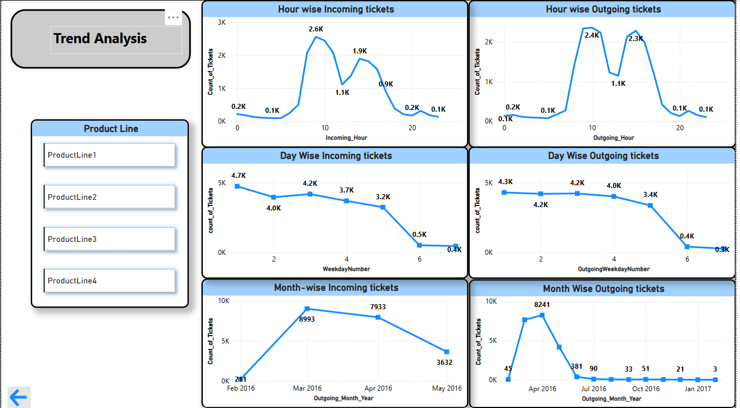
Final Project Outcome 2

Slide 6
Key Take-aways
1
High Resolution Rate & SLA Compliance
2
Resolution Time Analysis
3
Reopened Tickets & Quality of Resolutions
99.97% of tickets were resolved, demonstrating an efficient support system.
Only 9 SLA breaches, indicating strong adherence to service level agreements.
42.5% of tickets were resolved within 4 hours, showing effective handling of standard issues.
However, 34.84% of tickets took more than 72 hours, signaling backlogs or complex cases that need attention.
234 tickets were reopened, highlighting potential issues in first-time resolution quality.
This suggests that some tickets might have been closed prematurely or resolved incorrectly, requiring better quality control mechanisms.
4
Product Line-Wise Performance
4
Trend Analysis: Identifying High-Activity Periods
Product Line 1 had the highest ticket volume (11.9K tickets), suggesting a need for additional support resources.
Other product lines (5K, 2.2K, 1.6K tickets) had significantly lower ticket volumes, indicating they might require fewer resources or already have efficient resolution processes.
Peak ticket inflow times were observed at 10 AM and 4 PM, meaning these are the busiest support hours.
Daily trend analysis showed that the highest volume of tickets was generated on Day 1, with a decline towards Day 6 (possibly indicating a weekly support cycle).
Monthly trend analysis revealed a peak in March-April, followed by a decline.

Slide 7






Recommendations
Optimize Workforce Allocation
Allocate more resources during peak hours (10 AM & 4 PM) to reduce response time and backlog.
Implement AI-based ticket routing for faster issue resolution.
Strengthen Product Line 1 Support
57% of total tickets come from Product Line 1—needs better documentation & troubleshooting resources.
Analyze failure patterns to reduce issue recurrence.
Reduce Backlogs
Analyze tickets taking >72 hours to identify delays and improve workflows.
Introduce a dedicated escalation process for quicker resolution.
Improve Resolution Accuracy
Conduct root-cause analysis on 234 reopened tickets to address resolution gaps.
Implement post-resolution feedback to ensure issues are fully resolved.
Enhance Self-Service
Use FAQs, chatbots, and AI knowledge bases to reduce ticket volume.
Allow support teams to focus on critical issues.

Slide 8
Conclusion
The project successfully analyzed ServiceNow performance, providing data-backed insights on ticket resolution trends, peak hours, and product-specific workload distribution.
The high resolution rate (99.97%) and low SLA breaches (9 cases) indicate strong performance, but areas like backlogs (>72-hour tickets) and reopened cases (234 tickets) need improvement.
Key recommendations include better workforce management, enhanced self-service options, resolution accuracy improvements, and additional support for Product Line 1.
Future projects should focus on:
Refining ticket resolution processes to further reduce backlog cases.
Using predictive analytics to anticipate ticket volume fluctuations.
Strengthening root-cause analysis for reopened tickets to improve first-time resolution rates.
Final Thought:
This project reinforced the importance of data analytics in business decision-making, demonstrating how data-driven insights can optimize operational efficiency and enhance customer satisfaction.

Slide 9
Thank You

